Slide 1
Practical Machine Learning Recommender Engine and Anomaly Detection
Seth Juarez
sethj@devexpress.com
@sethjuarez
Analytics Program Manager
DevExpress

Slide 2




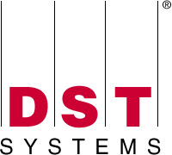





























Titanium Sponsors
Platinum Sponsors
Gold Sponsors

Slide 3
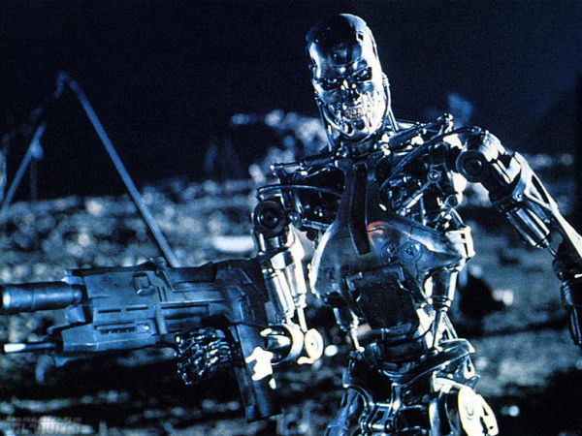
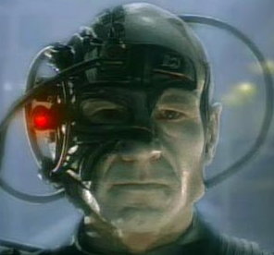


Slide 4
agenda
a word about data science
what is machine learning?
recommender systems
unsupervised learning – organization
k-means
hierarchical clustering
anomaly detection (motivation)

Slide 5
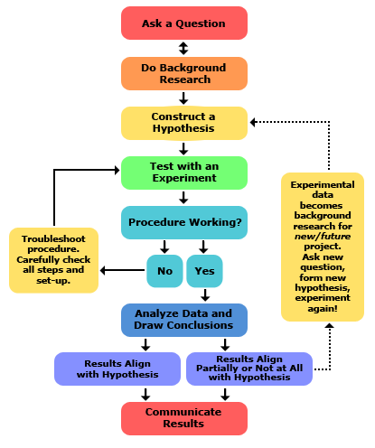
data science
key word: science
try stuff
it (might not | won’t) work the first time
http://www.sciencebuddies.org/science-fair-projects/project_scientific_method.shtml

Slide 6
machine learning
finding (and exploiting) patterns in data
replacing “human writing code” with “human supplying data”
system figures out what the person wants based on examples
need to abstract from “training” examples to “test” examples
most central issue in ML: generalization

Slide 7
machine learning
split into two (ish) areas
supervised learning
predicting the future
learn from past examples to predict future
unsupervised learning
understanding the past
making sense of data
learning structure of data
compressing data for consumption

Slide 8
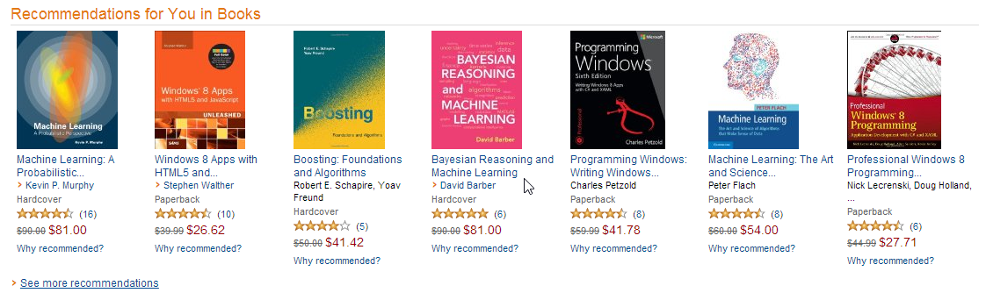
neat applications

Slide 9
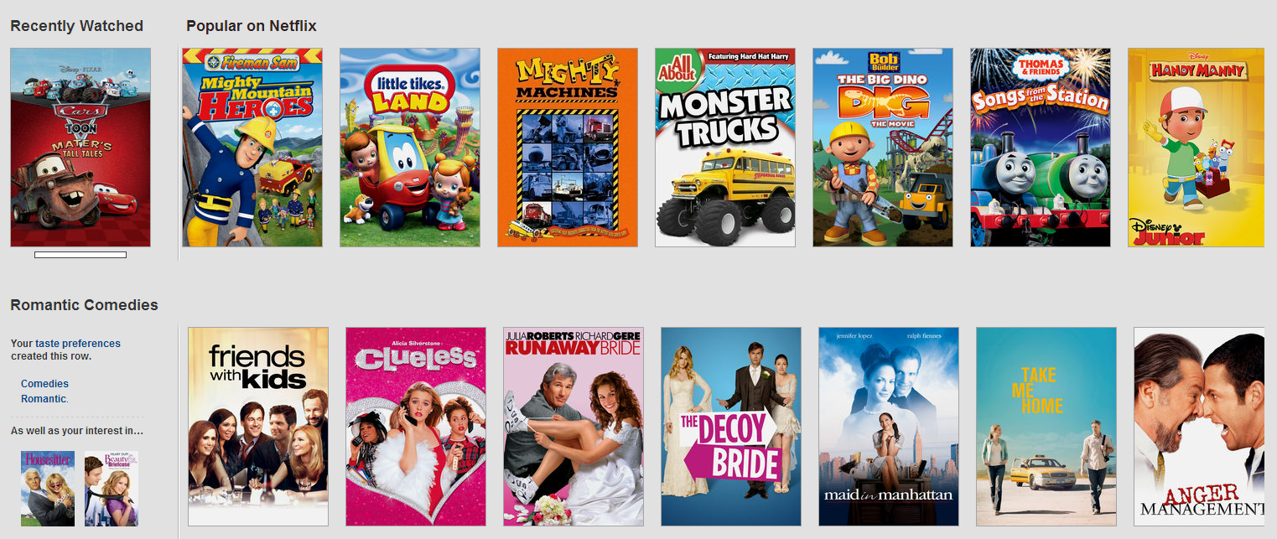
neat applications

Slide 10


neat applications
you can’t dance…

Slide 11
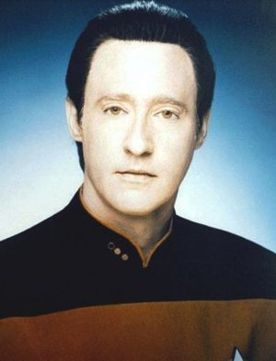
neat applications

Slide 12
neat applications
spam catchers
ocr (optical character recognition)
natural language processing
machine translation
biology
medicine
robotics (Autonomous Systems)
etc…

Slide 13
Recommender System

Slide 14










recommender systems
what do people like?
?

Slide 15
how does knowing people similarity
help when recommending something?

Slide 16










recommender systems
how are things alike?
?

Slide 17
how does knowing item similarity
help when recommending something?

Slide 18
Unsupervised Learning
figuring out similarity (among other things)

Slide 19
How Does it Work?

Slide 20
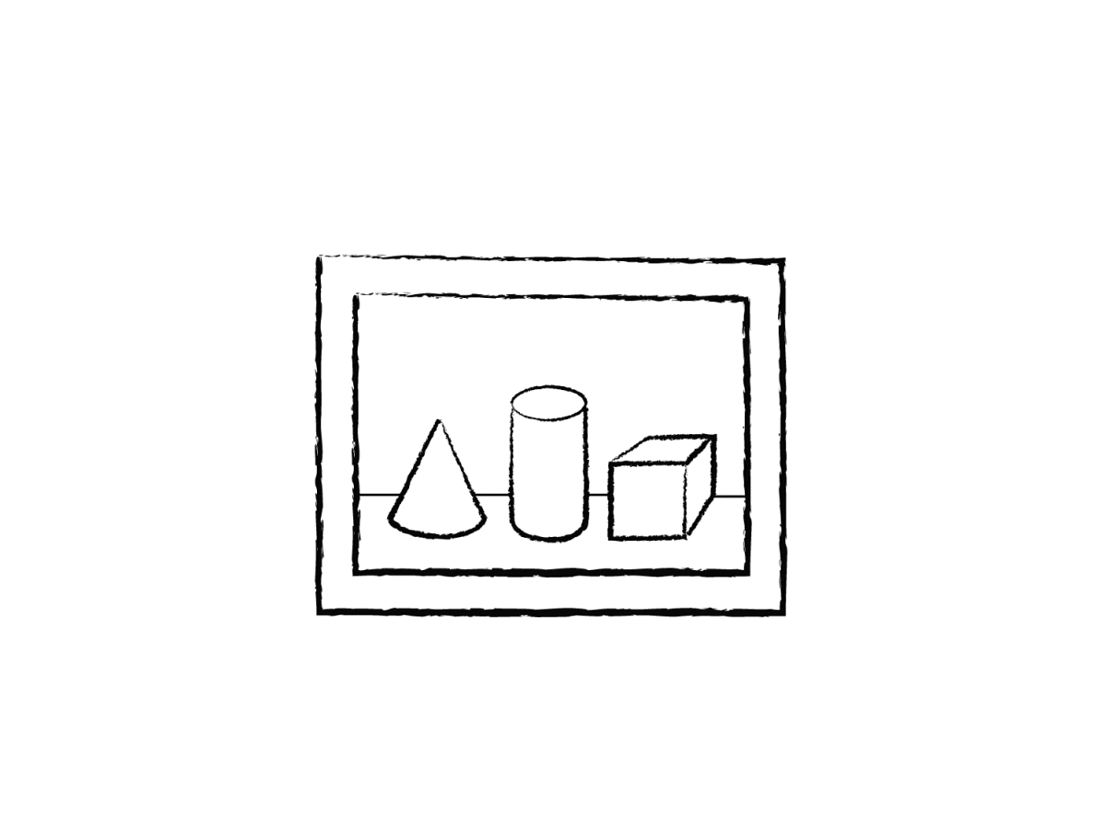
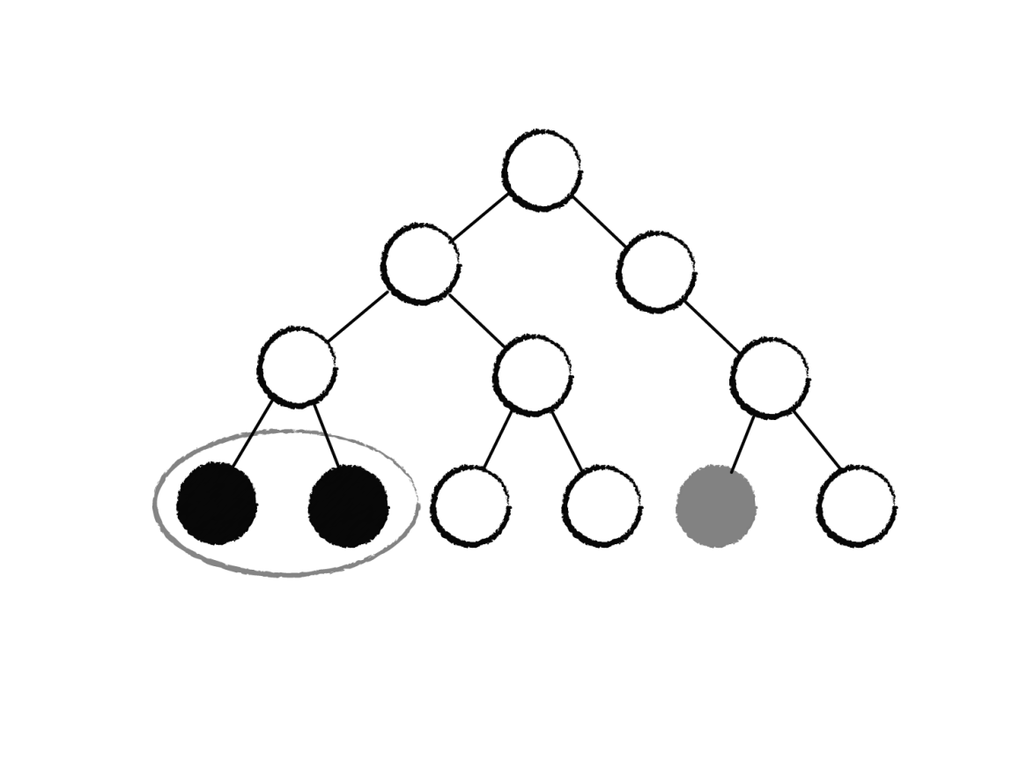
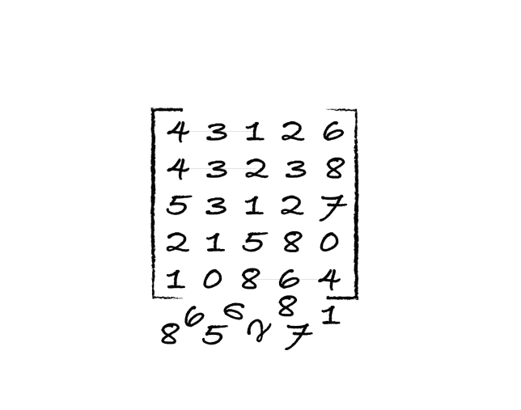
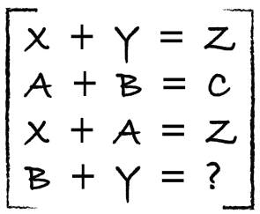
pattern
1. data
3. model
2. maths

Slide 21
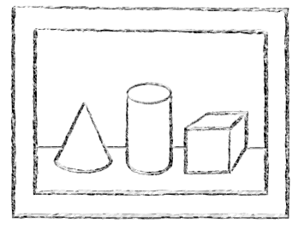
data – example
Grade | GPA | Age | Tall | Friends
A | 3.5 | 16 | Yes | 12
C | 2.0 | 12 | No | 3
F | 2.1 | 13 | Yes | 1
B | 3.5 | 17 | Yes | 6
D | 2.0 | 18 | No | 4
A | 3.8 | 15 | No | 6
D | 2.3 | 14 | No | 4
B | 3.3 | 17 | Yes | 8
features gpa, age, tall, friends
values (x) [A, 3.5, 16, Yes, 12]
which students are most similar? how should they be grouped? given a new student, where does she belong?

Slide 22
Do Something
code

Slide 23
Distance and Similarity
math

Slide 24
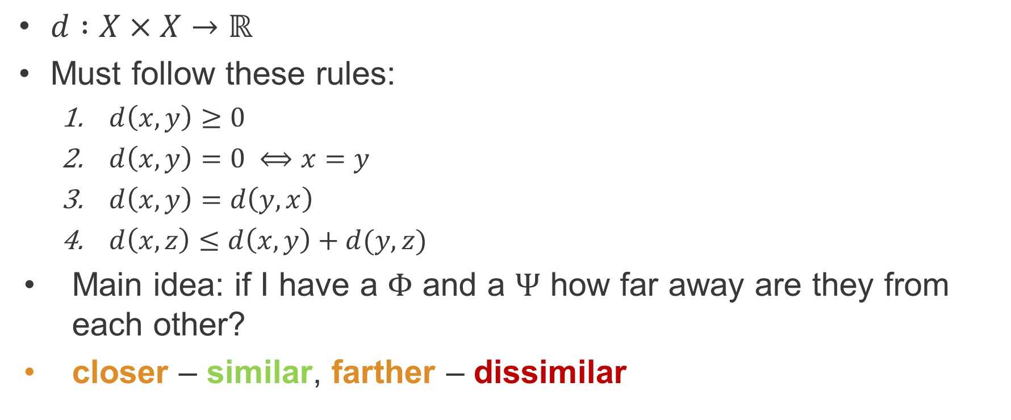
distance (metric)
$d :X×X→ℝ$
Must follow these rules:
$d\left(x,y\right)≥0$
$d\left(x,y\right)=0 ⟺x=y$
$d\left(x,y\right)=d\left(y,x\right)$
$d\left(x,z\right)≤d\left(x,y\right)+d(y,z)$
Main idea: if I have a $Φ$ and a $Ψ$ how far away are they from each other?
closer – similar, farther – dissimilar

Slide 25
distance
euclidian distance
manhattan distance
cosine distance
hamming distance

Slide 26
k-means
how it works
initialize K centers
find closest (distance) points to K centers
set each center to the average of the closest points
rinse and repeat until convergence

Slide 27
Demonstration
k-means

Slide 28
strings?!?!
the | red | dog | cat | eats | food
1 | 1 | 1 | 0 | 0 | 0
0 | 0 | 1 | 1 | 1 | 0
0 | 0 | 1 | 0 | 1 | 1
0 | 1 | 0 | 1 | 1 | 0
the red dog
cat eats dog
dog eats food
red cat eats

Slide 29
Recommending
collaborative filtering / content-based filtering

Slide 30
collaborative filtering
what people who are similar to me like?
?

Slide 31
content-based filtering
what items are similar to the one I chose?
?

Slide 32
Demonstration
collaborative filtering / content-based filtering

Slide 33
Similarity
other ways of measuring similarity

Slide 34
Hierarchical Clustering
models

Slide 35
clustering
linkage
single
average
centroid
complete

Slide 36
linkage
•f
•b
•d
•e
single
average
centroid
complete
•a
•c
•f
•b
•d
•a
•e
•c
•f
•b
•d
•a
•e
•c
•f
•b
•d
•a
•e
•c

Slide 37
Demonstration
hierarchical clustering

Slide 38
Anomaly Detection
brainstorm / motivation

Slide 39
anomaly detection
how could we use KMeans to detect anomalies?
step 1: get last n things and convert them to vectors (matrix)
step 2: get thing in question and add it to the bunch
step 3: run KMeans
step 4: measure distance of [new thing] from all centers
step 5: return min/avg/mode – whatever
step 6: tune (what is an acceptable threshold?)

Slide 40
anomaly detection
how could we use Hierarchical Clustering to detect anomalies?

Slide 41
recap
a word about data science
what is machine learning?
supervised
unsupervised
recommender systems, anomaly detection
k-means, hierarchical clustering
nuML – http://numl.net

Slide 42
planned
supervised learning:
support vector machines (non-linear classification models)
stochastic models (naïve bayes, etc.)
neural networks
simplified interface (system chooses appropriate model by interrogating label)
probabilistic graphical models
multi-processor, gpgpu

Slide 43
planned
unsupervised learning:
gaussian mixture models
latent semantic analysis (better pca for text)
self organizing maps
smarter interfaces (API to deal with reduction chaining)
multi-processor, gpgpu

Slide 44
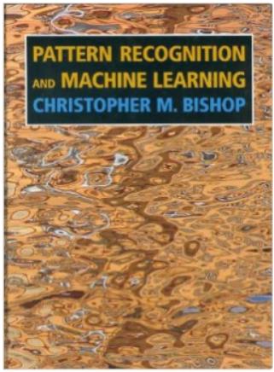
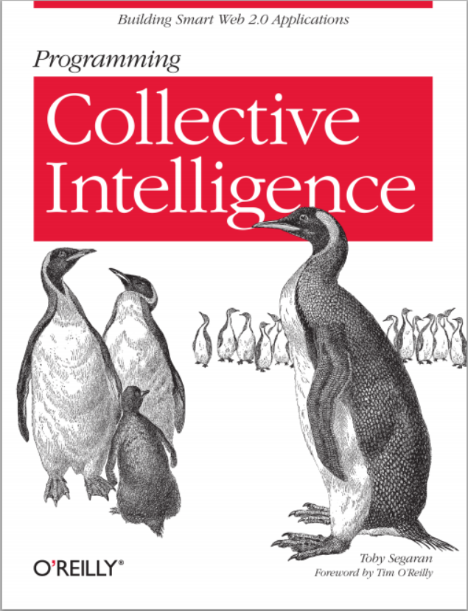
some reading

Slide 45
Questions?
Seth Juarez
sethj@devexpress.com
@sethjuarez
Analytics Program Manager
DevExpress

